Slide 1
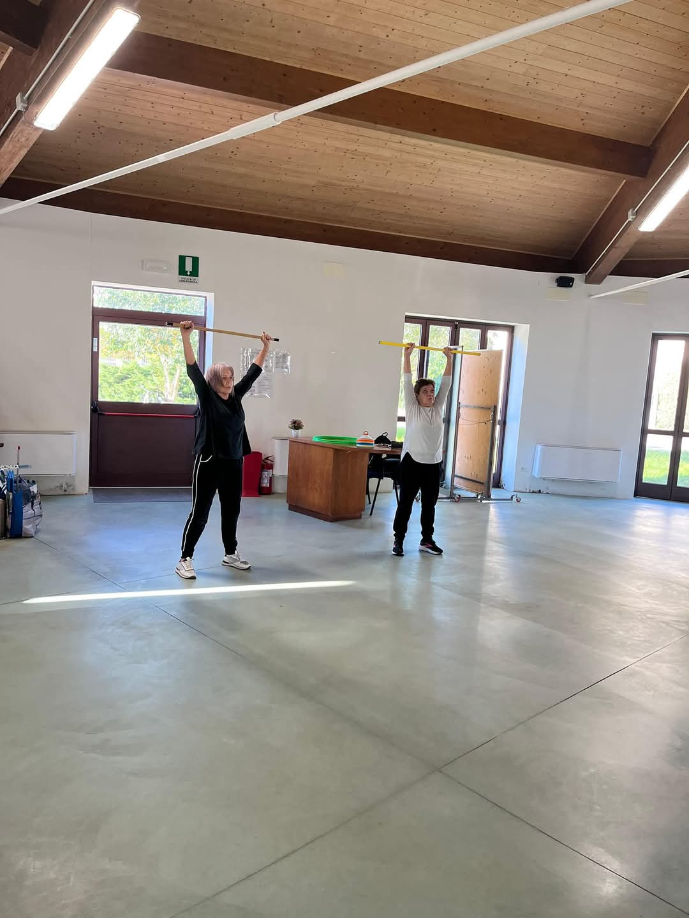
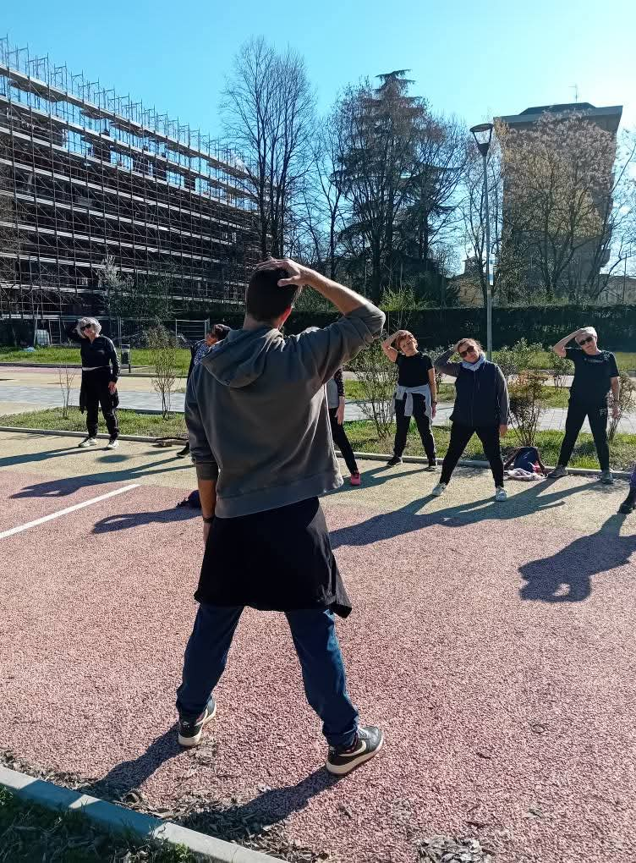
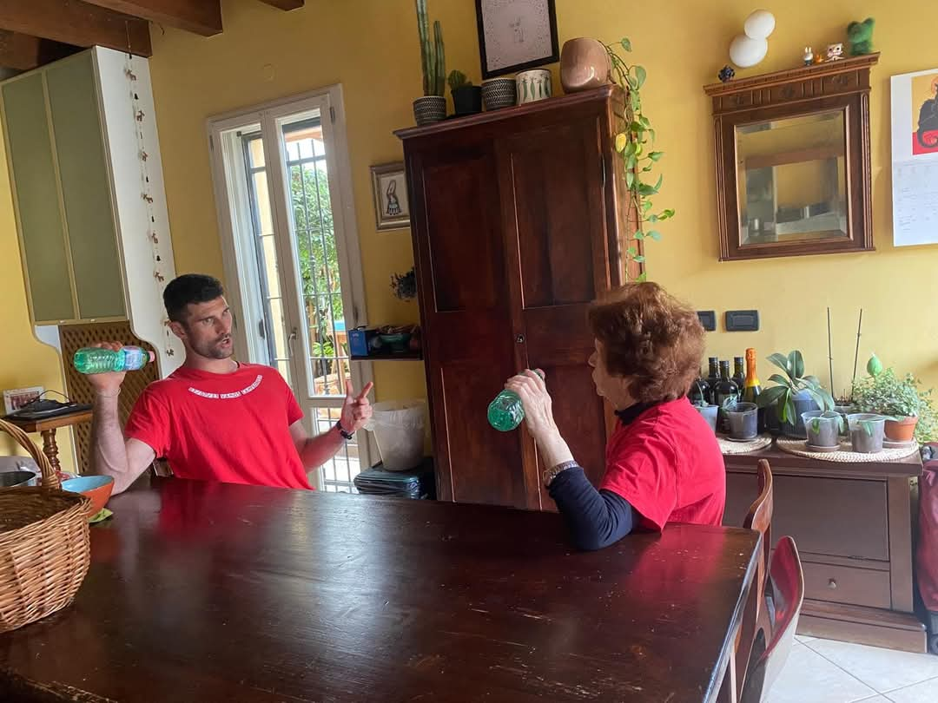
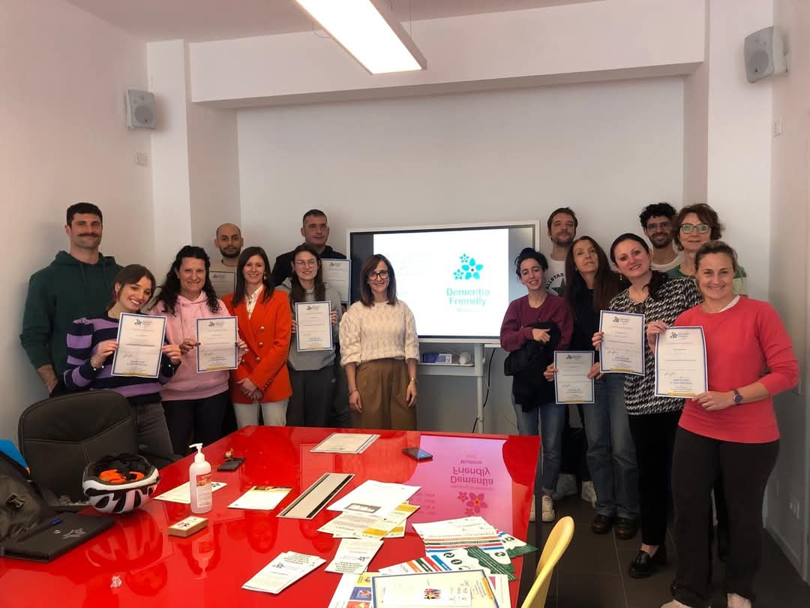
39° CONGRESSO NAZIONALE SIGOT – Modena 21-23/05/2025
ADAPTED PHYSICAL ACTIVITY FOR INDIVIDUALS WITH MAJOR NEUROCOGNITIVE DISORDERS
Acchiappati Vincenzo(1), Garzetta Glenda(1), Pellitta Antonella(1), Galli Chiara(1), Giordano Fabia(2), Tavoni Vera(2), Vaccina Antonella Rita(1), Manni Barbara(1).
(1) Community Geriatrics Unit - AUSL Modena, (2) UISP Modena
Introduction
The Cognitive Disorders and Dementia Centers (CDCD) participated in a funding call promoted by the Modena Foundation, submitting the project “Prevention and Inclusion: Strategies to Improve the Quality of Life of Older Adults within the Community.” The project aims to foster prevention and social inclusion by promoting access to adapted physical activity for individuals with cognitive impairments. This study focuses on a specific segment of the project, conducted in collaboration with UISP (Italian Association of Sport For All).
Objective
The primary aim was to evaluate the feasibility of the initiative, by involving at least 110 individuals over an 18-month period. Secondary aims included assessing quality of life, mood, cognitive functioning, physical health parameters, and fall risk among individuals with dementia.
Participants
Participants were recruited from the CDCD centers of Modena and Castelfranco Emilia. Inclusion criteria were: living at home, being supported by a cooperative caregiver, and having a diagnosis of mild to moderate major neurocognitive disorder (CDR 0.5–2) established by the CDCD between October 2024 and December 2025. Exclusion criteria included severe dementia (CDR 3), relevant psychiatric comorbidities, or uncooperative caregivers. An initial evaluation (T0) was carried out by a kinesiologist with a Master’s Degree in Adapted Physical Activity (AMPA) from the Community Geriatrics Team, using the following tools:
Quality of Life in Alzheimer’s Disease scale (QoL-AD)
Short Physical Performance Battery (SPPB)
Memory Assessment Clinical Questionnaire (MAC-Q)
Geriatric Depression Scale (GDS-15)
Falls Efficacy Scale – International (FES-I)
Number of falls in the past year
Participants could then engage in one of the following modalities: (1) home-based individual activity, (2) small group gym sessions, or (3) outdoor group training. All physical activity sessions were led by UISP kinesiologists and focused on strength training, aerobic conditioning, balance, mobility, and cognitive stimulation. Re-evaluations are scheduled at 3 months (T1) and 12 months (T2) post-enrollment.
Note Participants were distributed across three modalities: gym-based, outdoor activities and home-based individual activity
Results
Data collected within the first six months demonstrated high participation rates. Out of 188 eligible individuals, 113 evaluations were completed; 37 declined participation, and 38 were placed on a waiting list. Of those assessed, 28 later opted out, 7 are pending program initiation, and 78 have begun the physical activity interventions. Among participants, 31 were assigned to home-based activities, 40 to gym-based groups, and 7 to outdoor activities. Follow-up assessments will be conducted after three months to evaluate secondary outcomes.
Conclusions
Preliminary findings suggest that the program is feasible and holds promising benefits for the well-being and social inclusion of individuals with dementia. High levels of engagement and motivation were observed among patients, caregivers, and professionals. Further research will help to clarify the program’s effects on the assessed outcomes.
Note Graphic representation of participants and activities
Preliminary results show promising participation and engagement rates. Data indicate a strong willingness to be involved in structured preventive pathways. The decline and the waitlist rates are aligned with expectations for interventions targeting older adults with cognitive impairments, considering comorbidities, caregiver burden, and logistical challenges.
The high adherence underscores the feasibility and perceived value of adapted physical activity among this target population. Nonetheless, 28 participants opted out after the assessment phase, suggesting the need to further investigate potential barriers, such as motivational, functional, or environmental factors.
The preference for structured group settings, particularly gyms, may reflect a desire for social engagement and support. This is consistent with the project's inclusion goals, which extend beyond physical benefits to target cognitive stimulation and reduced isolation.
The upcoming three-month follow-up assessments will be critical to evaluating the effectiveness of the intervention in terms of secondary outcomes such as mood, cognitive performance, and perceived quality of life. These data will contribute to refining the intervention and exploring its potential scalability within regional healthcare services.
Corresponding author: v.acchiappati@ausl.mo.it

